Slide 1
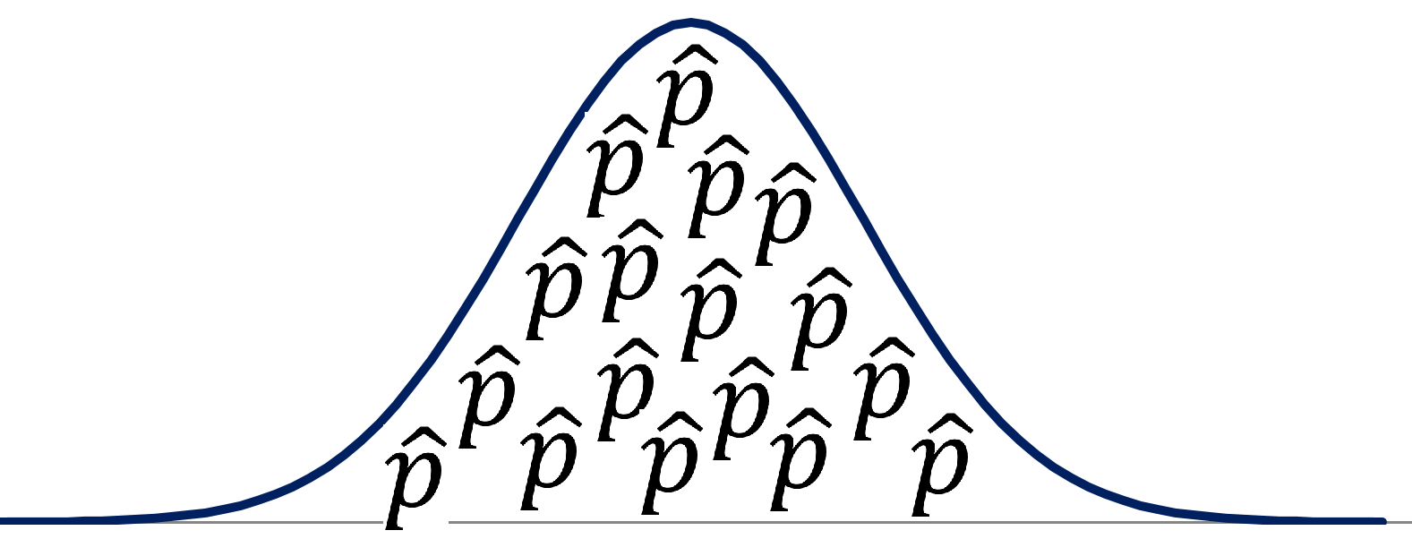

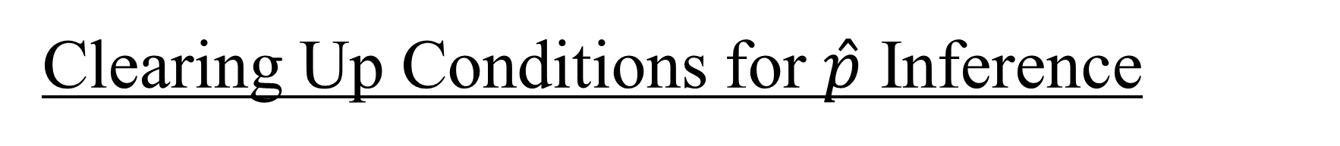
Clearing Up Conditions for $\hat{p}$ Inference
How do I know $\hat{p}$ will follow a normal model?
Let’s go back to the basics.

Slide 2
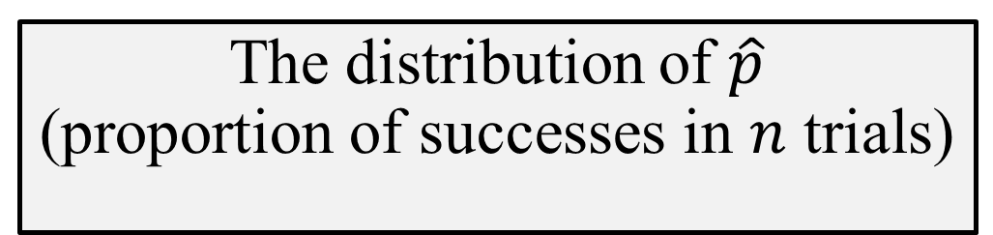
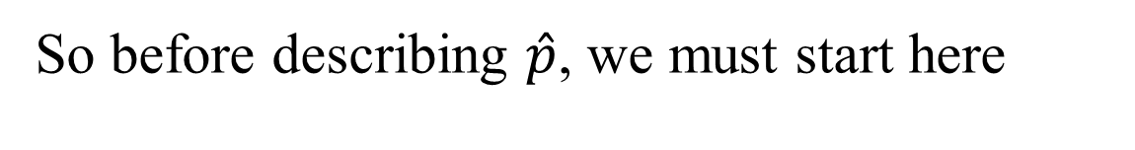
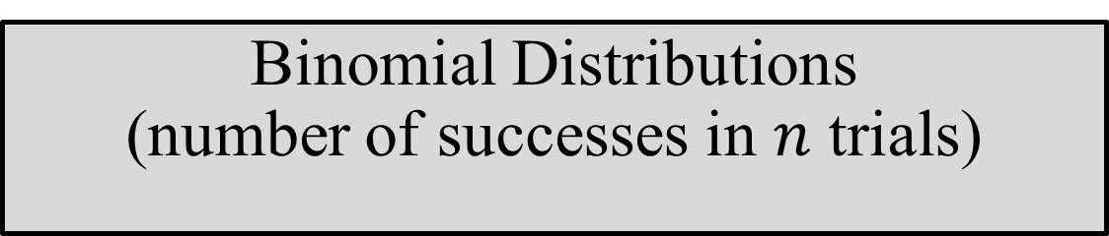
How Does the Math Work?
The math for this
…actually depends on this
…which only works for this
The distribution of $\hat{p}$
(proportion of successes in $n$ trials)
Binomial Distributions
(number of successes in $n$ trials)
Bernoulli Trials
2 possible outcomes
One S/F does not affect the next (“Ind ”)
So before describing $\hat{p}$, we must start here

Slide 3
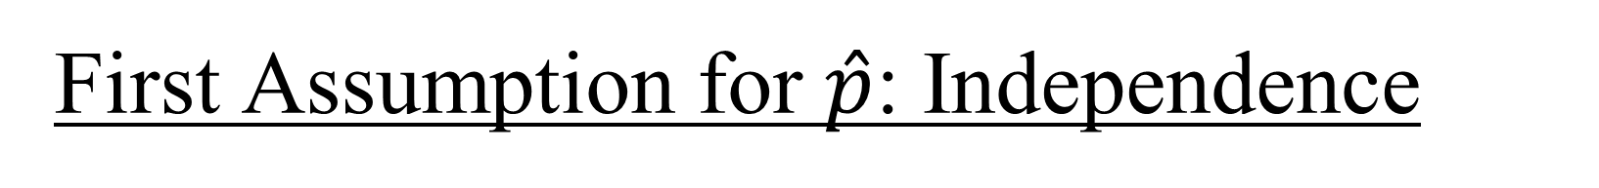
First Assumption for $\hat{p}$: Independence
For a given scenario, the math requires that one outcome does not affect the next. This will either be…
True
“Alice is going to roll a die 30 times…”
Maybe true
“Benny is going to catch 30 fish from a pond of 100 fish (25% trout) ,
letting each one go after he catches it…”
False, but hopefully not too bad. Our math will still be close enough.
“Charlie is going to catch 30 fish from a lake of 10,000 fish (25% trout),
NOT letting them go…”
To be specific, the problem with Charlie is that he is
sampling
without replacement
from a finite population.
(This is what will lead us to the 10% condition.)

Slide 4
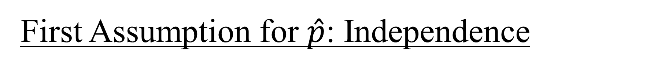
First Assumption for $\hat{p}$: Independence
Sometimes this is plainly true
“Alice is going to roll a die 30 times…”
So we do not need…
…to mention a randomization process. The results are already random
…any 10% condition. (10% of what? All the rolls she will do in her lifetime? That’s weird.)
Just say, “One die roll does not affect the next.”
Done.
Do we need the 10% condition?
sampling
without replacement
from a finite population.
Notes:
No, we don’t need the 10% condition.

Slide 5
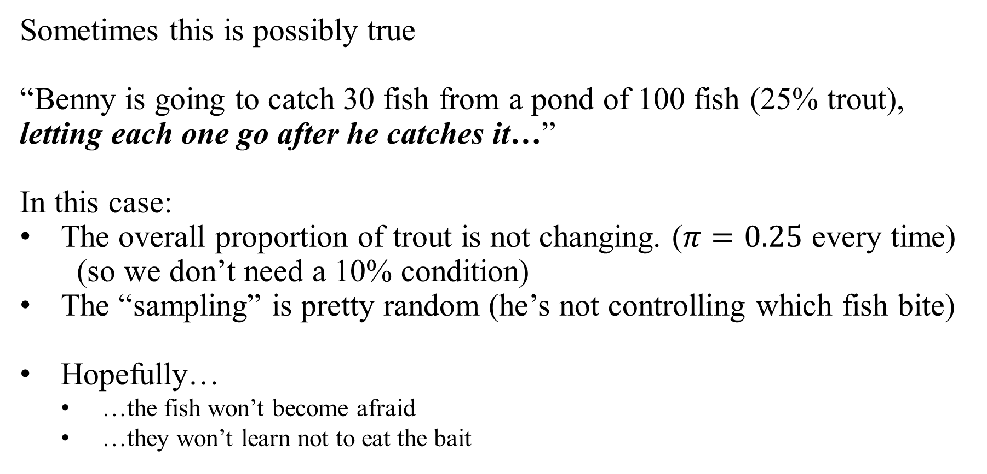
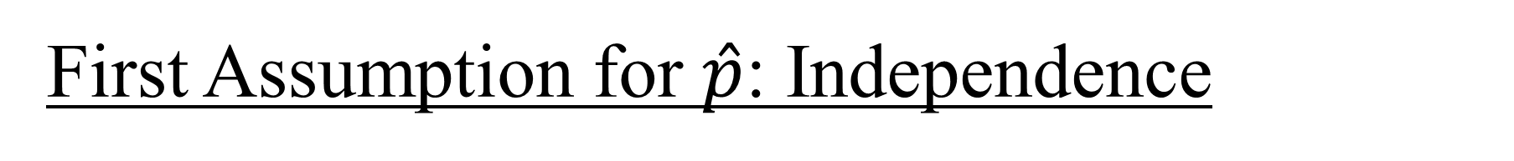
First Assumption for $\hat{p}$: Independence
Sometimes this is possibly true
“Benny is going to catch 30 fish from a pond of 100 fish (25% trout), letting each one go after he catches it…”
In this case:
The overall proportion of trout is not changing. ($π=0.25$ every time) (so we don’t need a 10% condition)
The “sampling” is pretty random (he’s not controlling which fish bite)
Hopefully…
…the fish won’t become afraid
…they won’t learn not to eat the bait
Do we need the 10% condition?
sampling
without replacement
from a finite population.
Notes:
No, we don’t need the 10% condition.

Slide 6

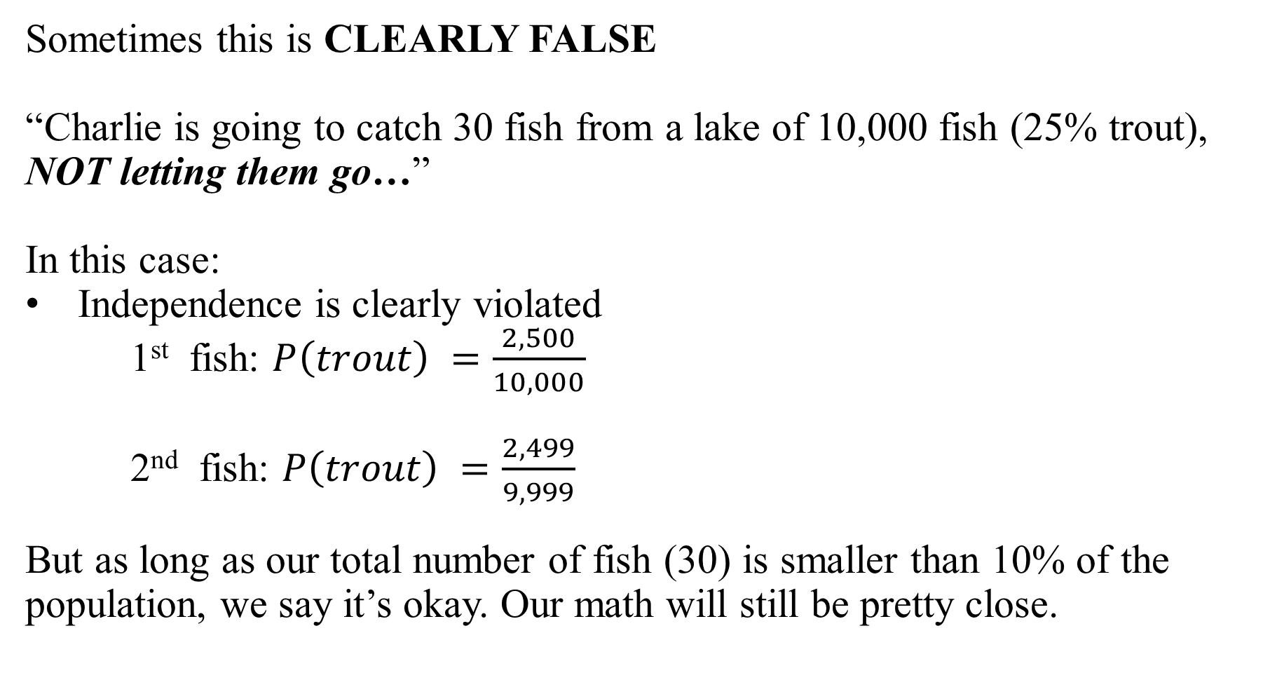
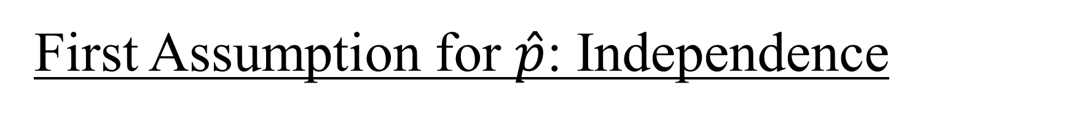
First Assumption for $\hat{p}$: Independence
Sometimes this is CLEARLY FALSE
“Charlie is going to catch 30 fish from a lake of 10,000 fish (25% trout), NOT letting them go…”
In this case:
Independence is clearly violated
1st fish: $P\left(trout\right) =\frac{2,500}{10,000}$
2nd fish: $P\left(trout\right) =\frac{2,499}{9,999}$
But as long as our total number of fish (30) is smaller than 10% of the population, we say it’s okay. Our math will still be pretty close.
Bernoulli Trials
2 possible outcomes
One S/F does not affect the next (“Ind ”)
10% condition?
s .
w r .
from a f p .
Notes:
Or the 2nd trout could be 2500/9999 if the first was a failure. Not necessary to dig into that if the goal is just to show that probabilities change.

Slide 7
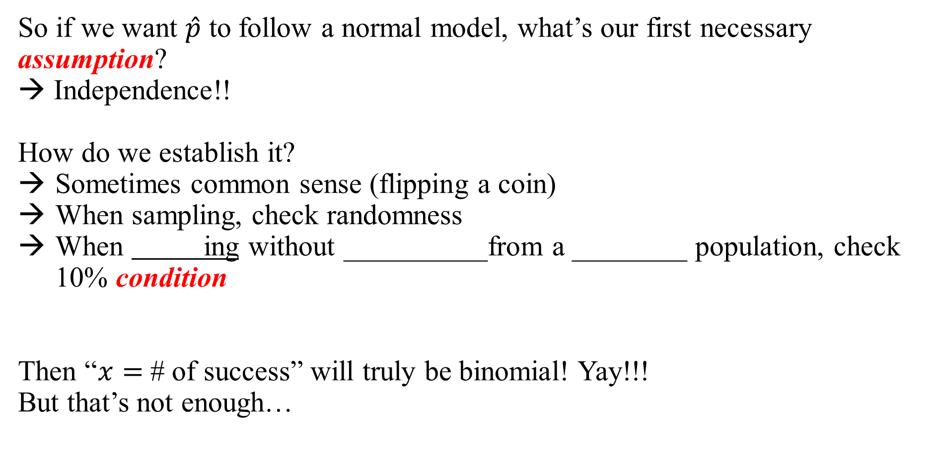
First Assumption for $\hat{p}$: Independence
So if we want $\hat{p}$ to follow a normal model, what’s our first necessary assumption?
→ Independence!!
How do we establish it?
Sometimes common sense (flipping a coin)
When sampling, check randomness
When ing without __________from a ________ population, check 10% condition
Then “$x=$ # of success” will truly be binomial! Yay!!!
But that’s not enough…

Slide 8
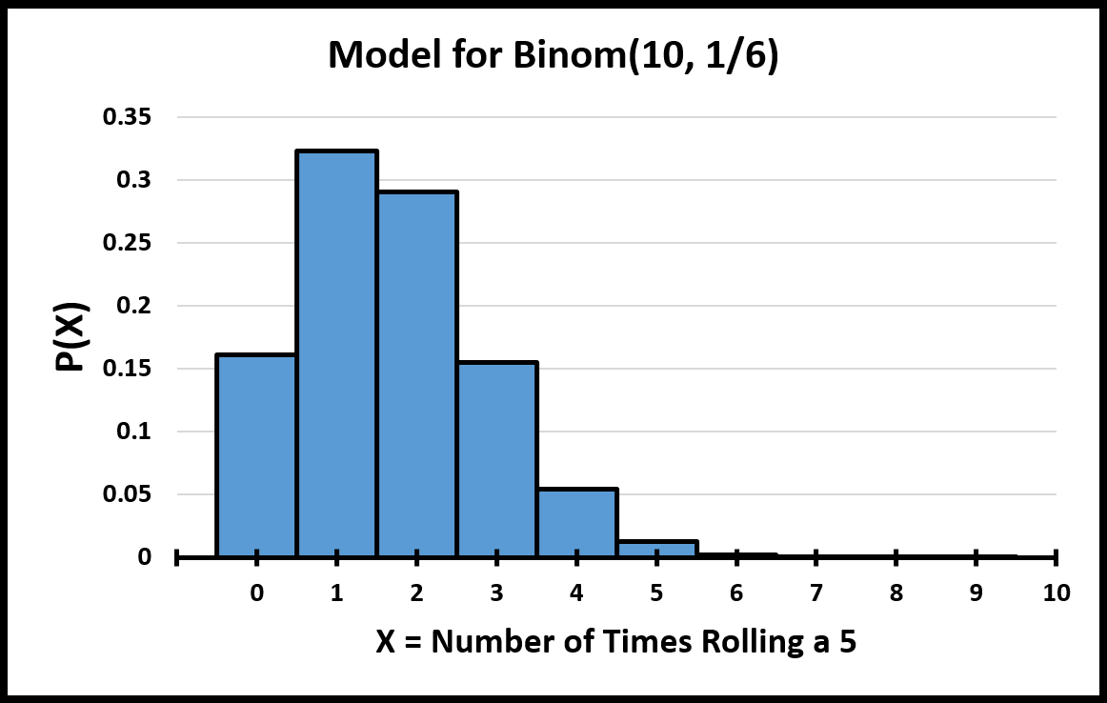
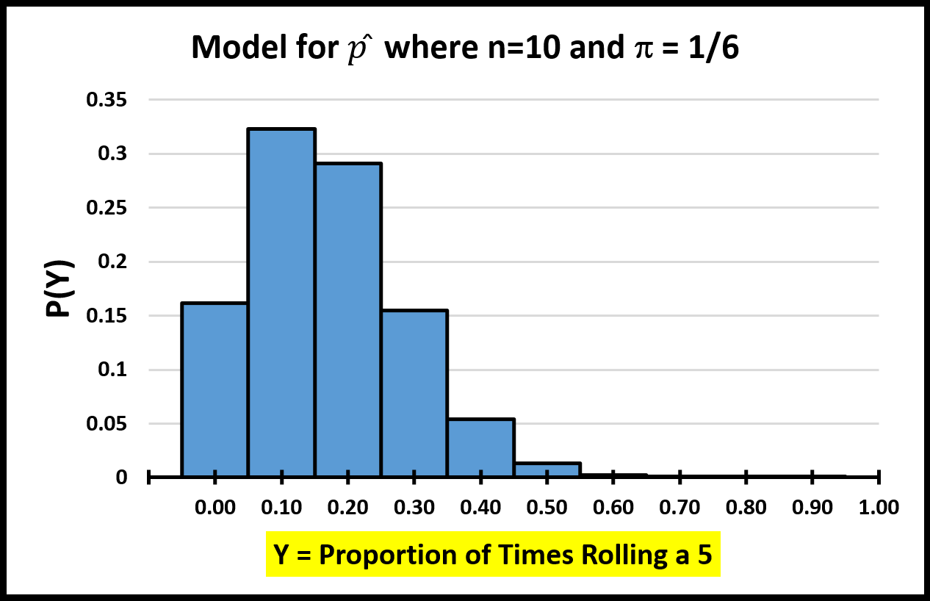
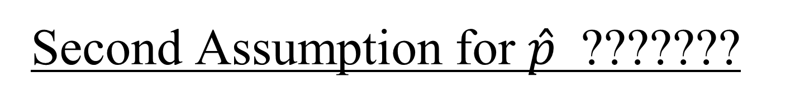

Second Assumption for $\hat{p}$ ???????
Here is an example of a…
real…
true…
nobody-doubts-it…
wonderful…
binomial distribution:
Here is the corresponding distribution for $\hat{p}$
☹What’s wrong??? Why can’t we use CLT?
Notes:
Distribution is not normal.

Slide 9
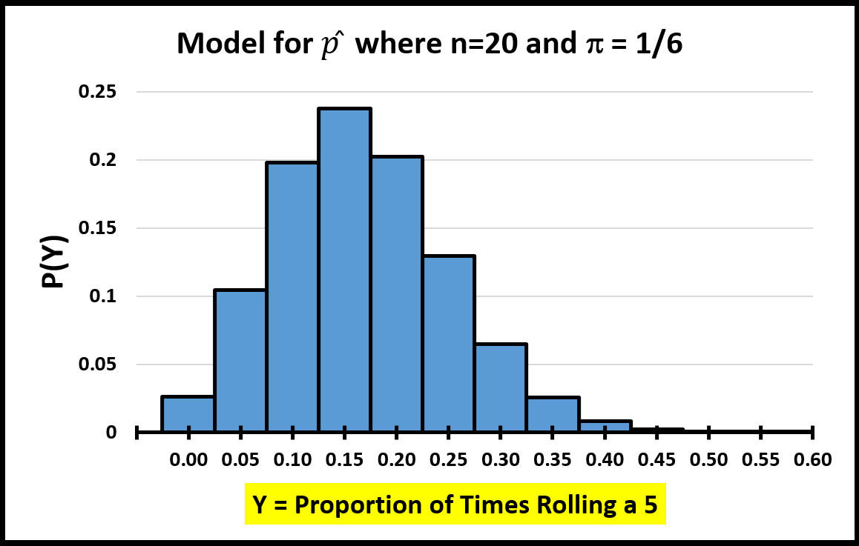
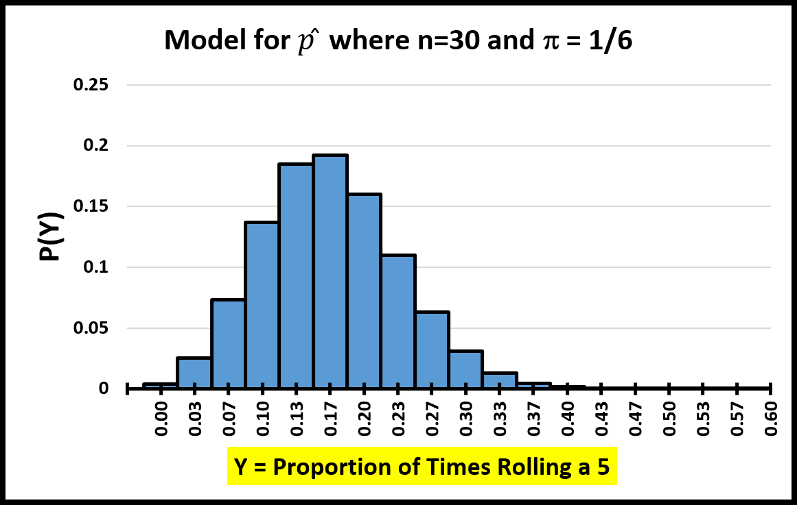

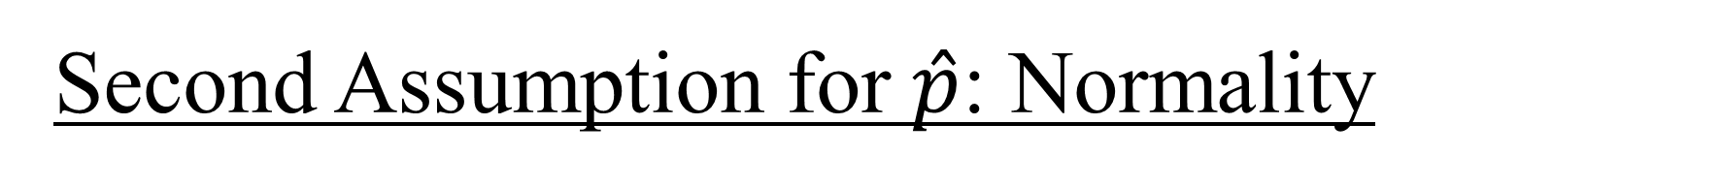
Second Assumption for $\hat{p}$: Normality
Before doing our math, we need to know that $\hat{p}$ follows a normal model. When will this be true?
Never ☹
When will it be “close enough”? ← (this will give us a “condition”)
$n=10$ $n=20$ $n=30$

Slide 10
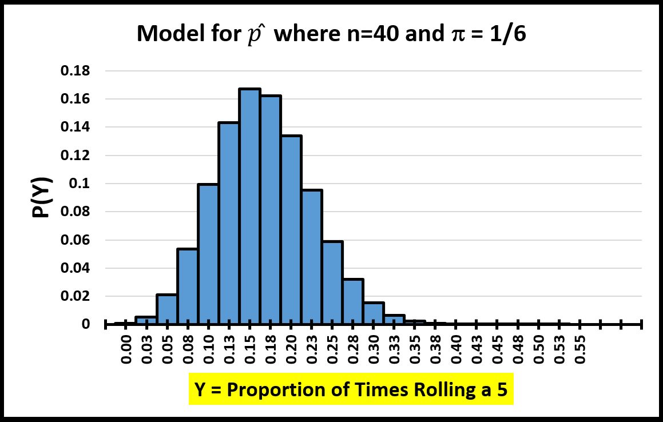
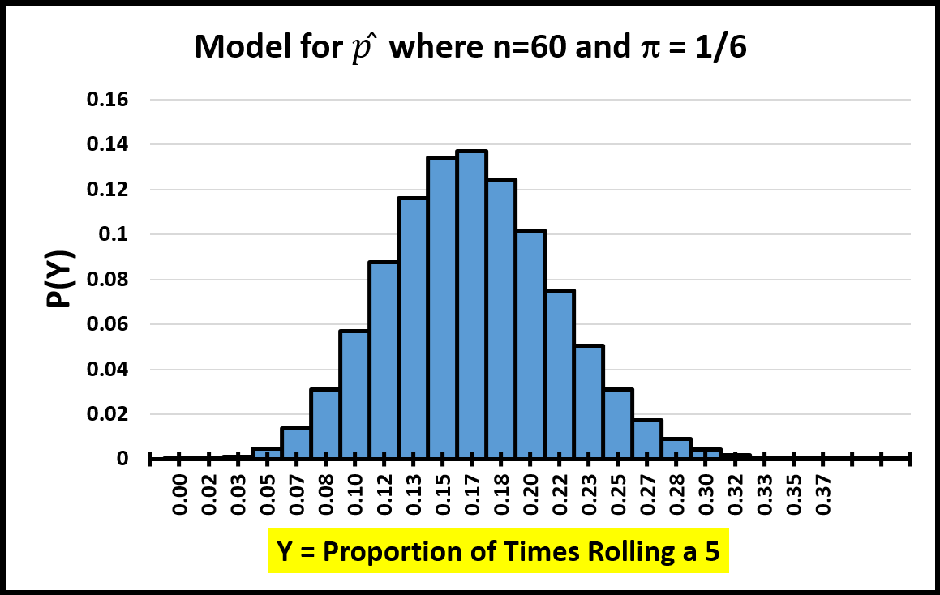
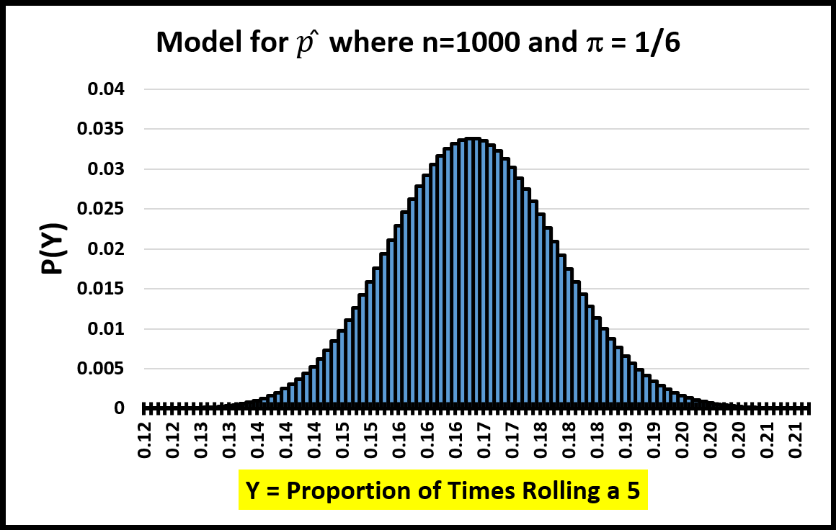

Second Assumption for $\hat{p}$: Normality
Before doing our math, we need to know that $\hat{p}$ follows a normal model. When will this be true?
Never
When will it be “close enough”? ← (this will give us a “condition”)
$n=40$ $n=60$ $n=1000$
Notes:
n=60 matches with barely satisfying the 10% condition.

Slide 11
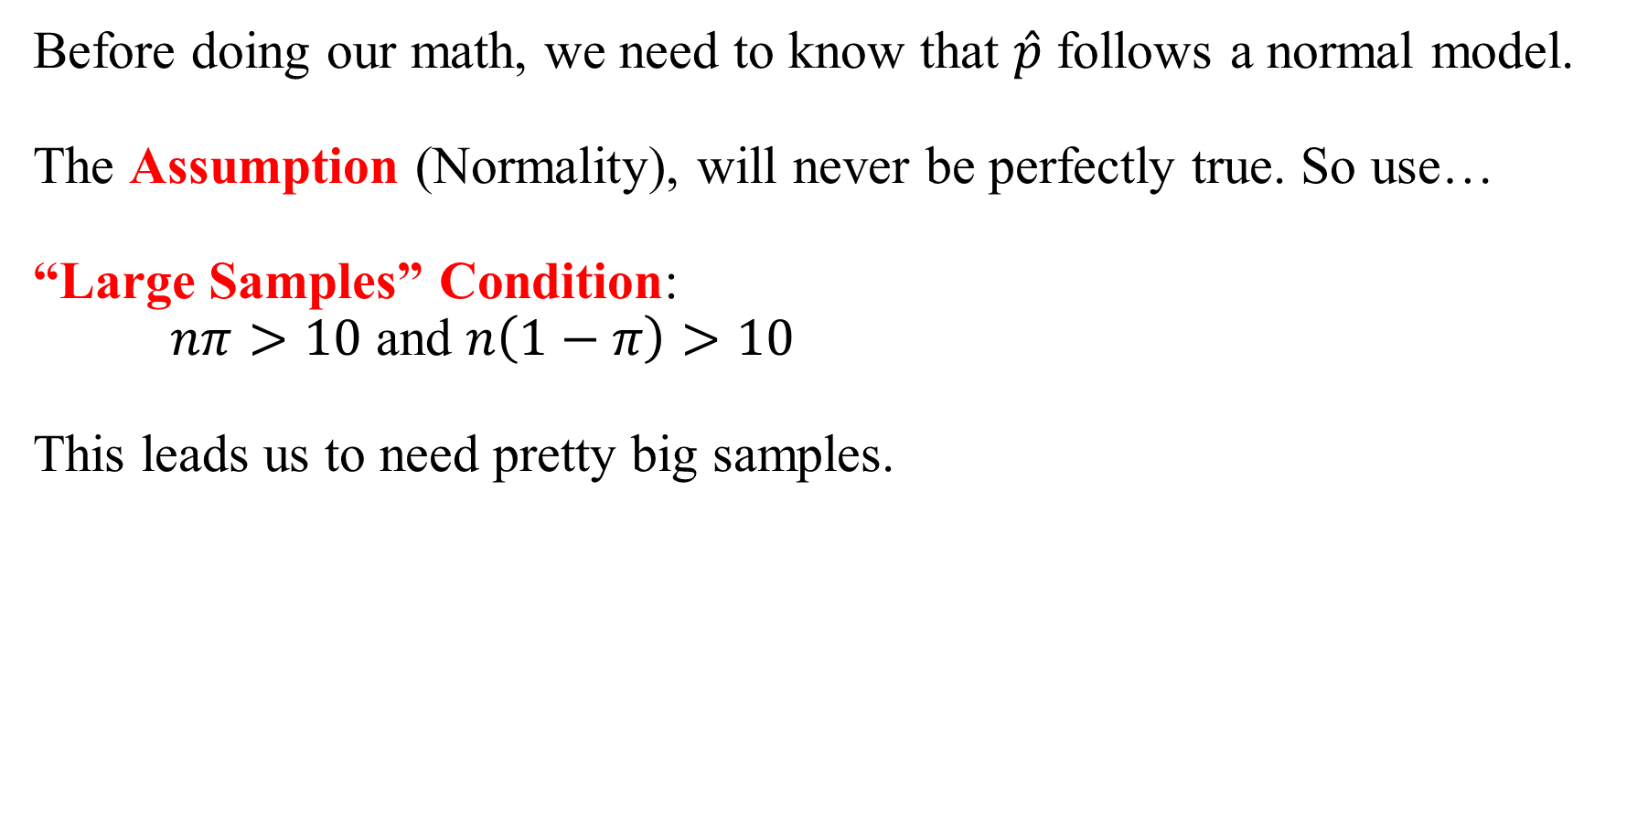
Second Assumption for $\hat{p}$: Normality
Before doing our math, we need to know that $\hat{p}$ follows a normal model.
The Assumption (Normality), will never be perfectly true. So use…
“Large Samples” Condition:
$nπ>10$ and $n\left(1−π\right)>10$
This leads us to need pretty big samples.

Slide 12
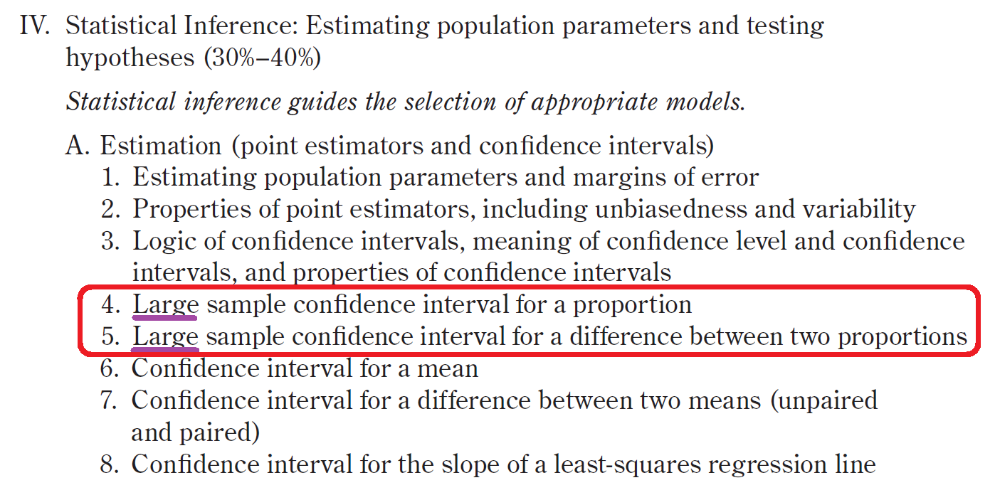
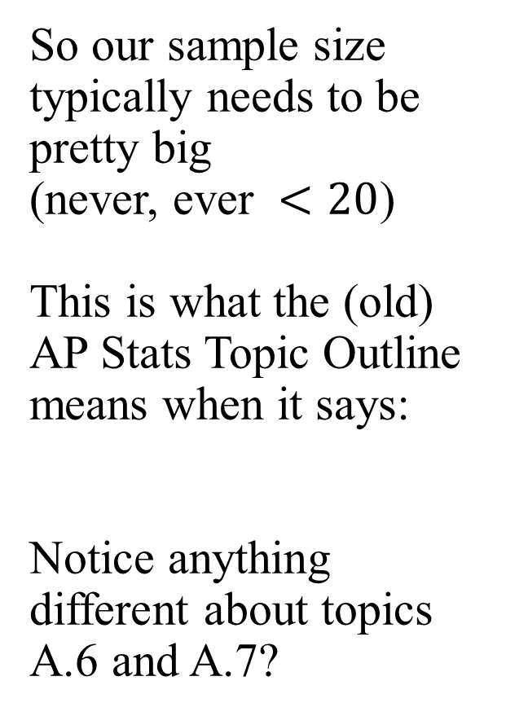
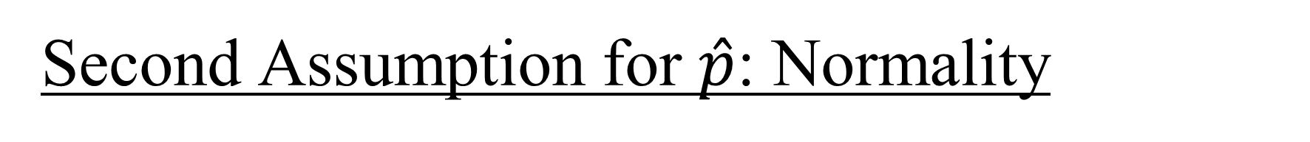
Second Assumption for $\hat{p}$: Normality
So our sample size typically needs to be pretty big
(never, ever $<20$)
This is what the (old) AP Stats Topic Outline means when it says:
Notice anything different about topics A.6 and A.7?
Notes:
For means, we will have a way of dealing with small samples

Slide 13
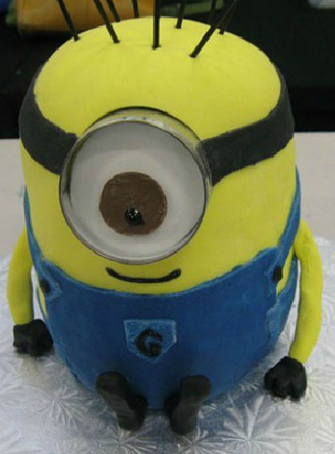
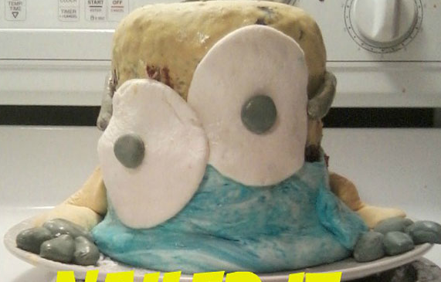
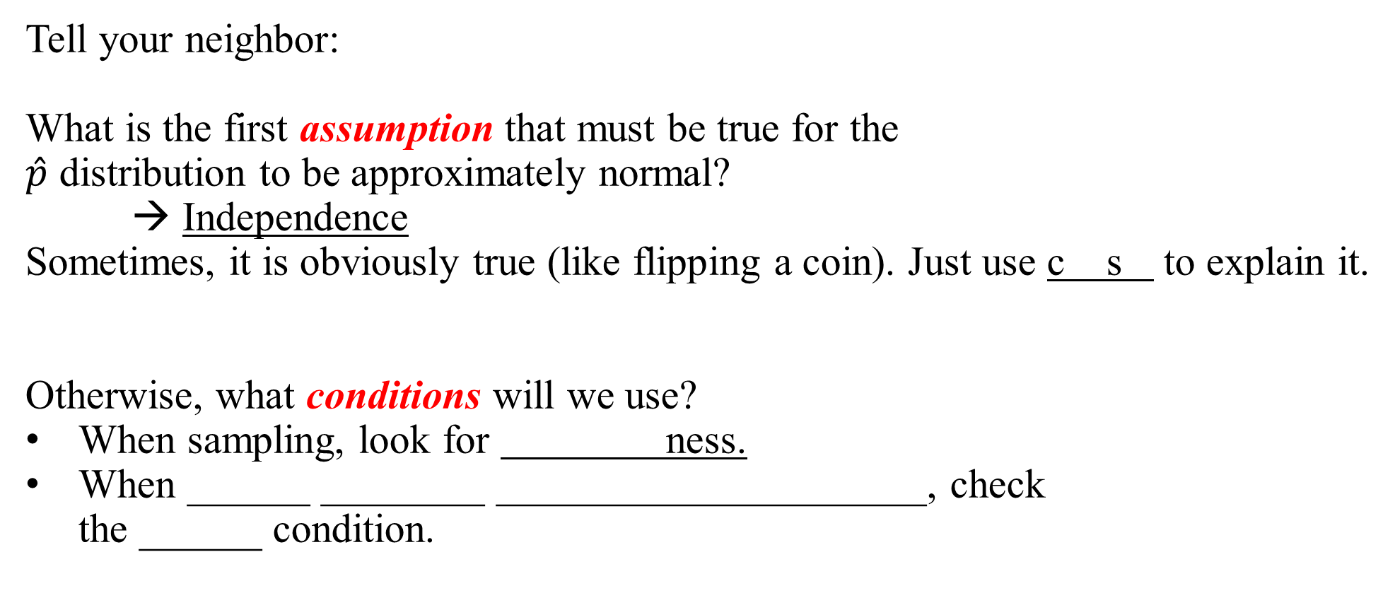
Review: 2 Assumptions
Tell your neighbor:
What is the first assumption that must be true for the $\hat{p}$ distribution to be approximately normal?
→ Independence
Sometimes, it is obviously true (like flipping a coin). Just use c s to explain it.
Otherwise, what conditions will we use?
When sampling, look for ness.
When ______ ________ _____________________, check the ______ condition.
Notes:
cs → common sense
Randomness
Sampling Without Replacement from a Finite Population…10%

Slide 14
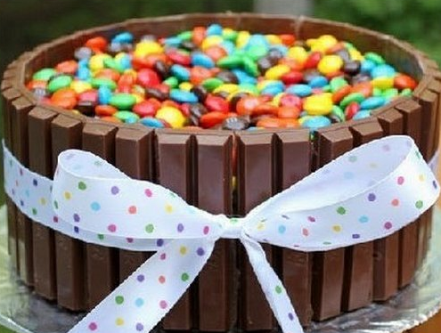
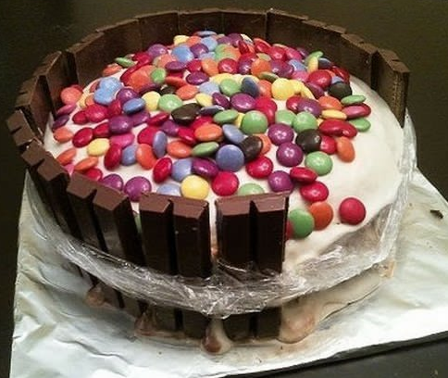
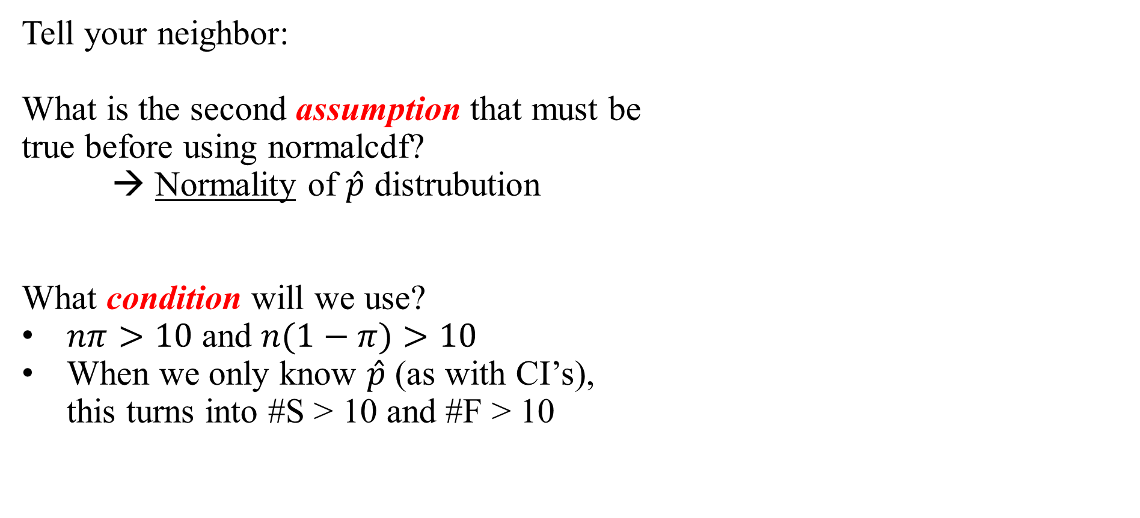
Review: 2 Assumptions
Tell your neighbor:
What is the second assumption that must be true before using normalcdf?
→ Normality of $\hat{p}$ distrubution
What condition will we use?
$nπ>10$ and $n(1−π)>10$
When we only know $\hat{p}$ (as with CI’s), this turns into #S > 10 and #F > 10

Slide 15
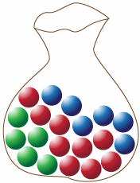
Final Note
The 10% condition is only used when we are…
It is not used for experiments. Check out the rubric from this experiment FRQ (2015 #4)
.
.
.

Slide 16
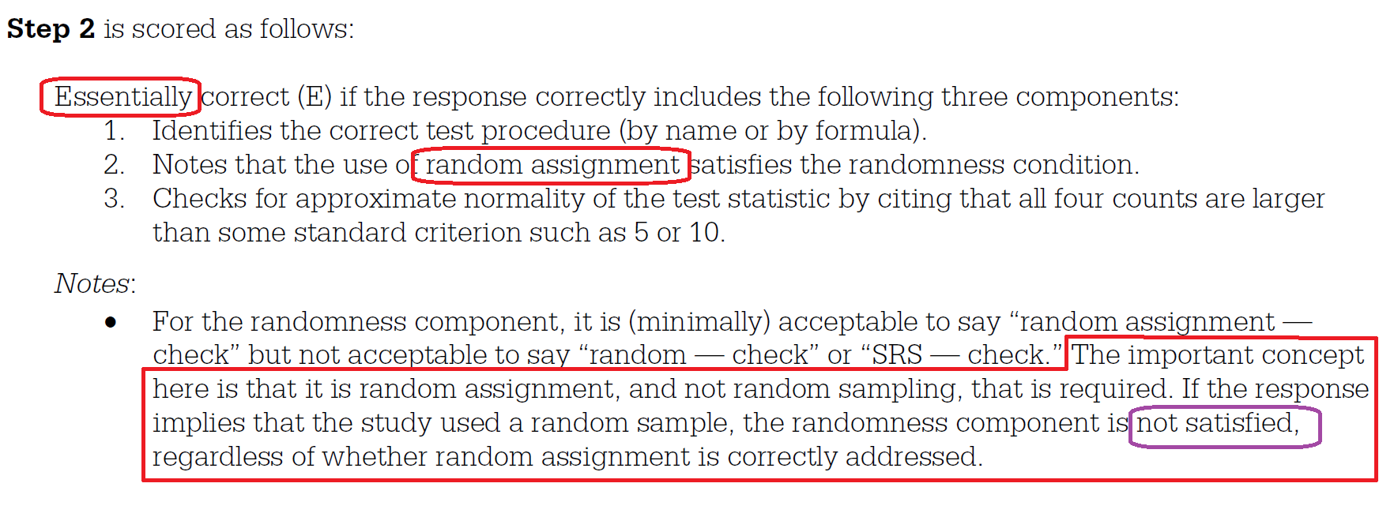
Final Note
.
.
.

